Slide 1

Human Rights Violations and the Wagner Group: An Analysis
Amir Haviv
5/11/2023

Slide 2
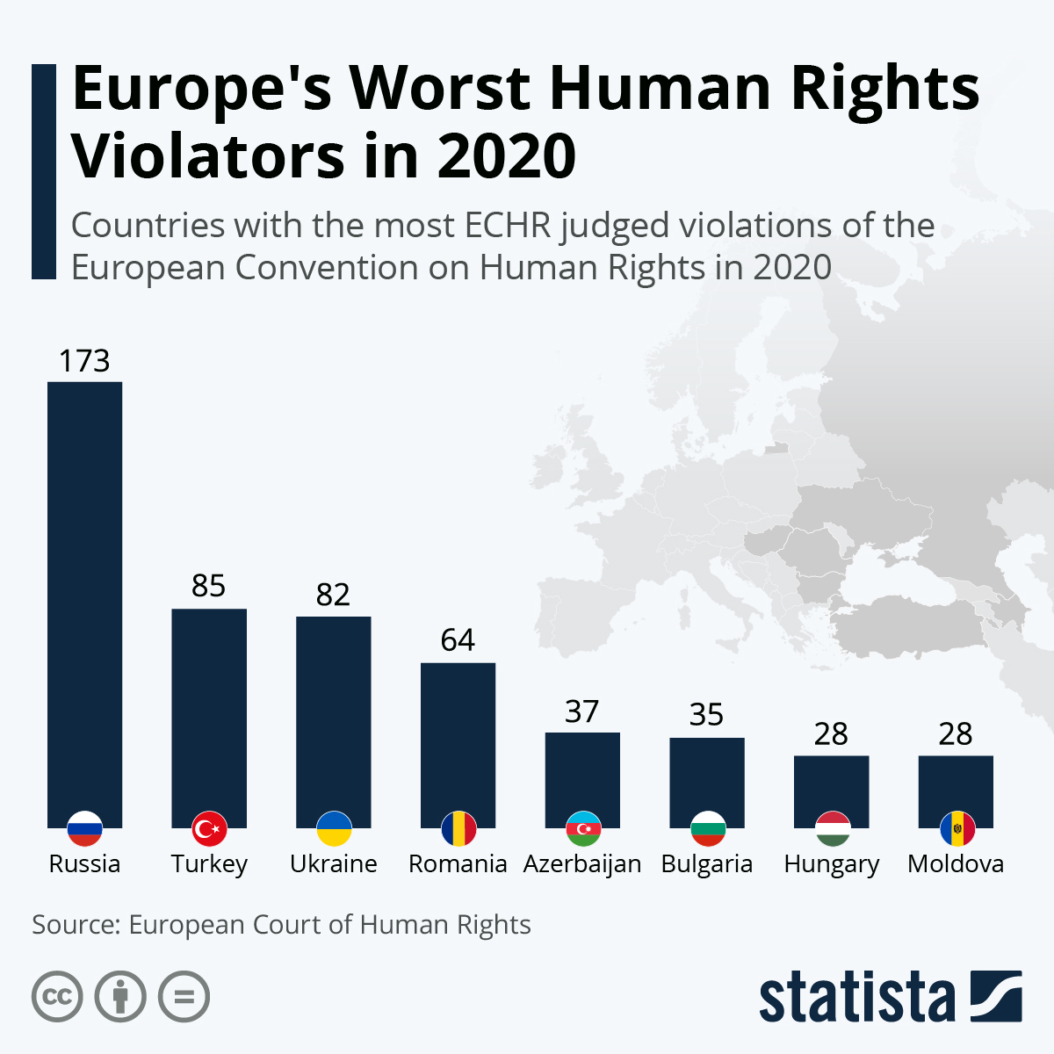
Introduction
Human rights violations often occur in the shadows
Wagner Group, a private military organization with ties to the Russian government
Known for involvement in various wars, raising concerns about human rights violations

Slide 3



Project Overview
Primary goal: create a heatmap highlighting countries where the Wagner Group may have violated human rights
Data collection methods: Web Scraping

Slide 4
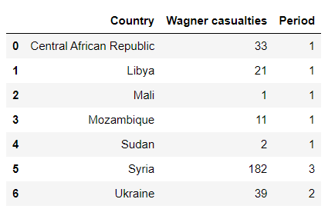
Data Collection and Organization
Identified most known foreign operations of the Wagner Group using Wikipedia
Imported data and created a separate table consolidating all the events in a single country
Showing in on the two different maps

Slide 5
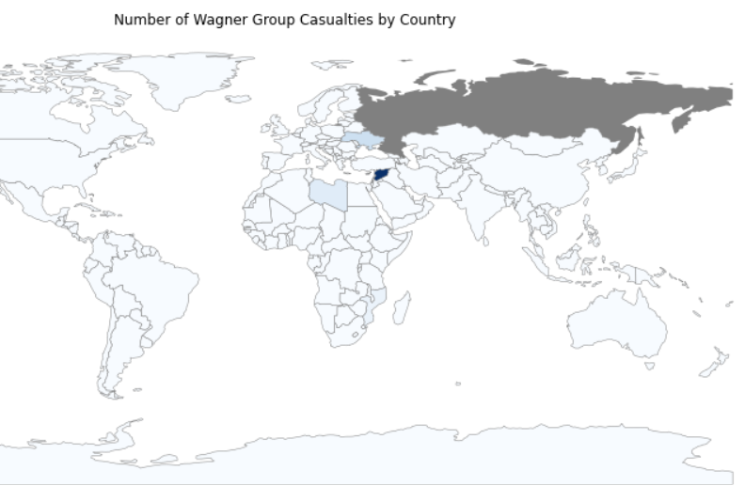
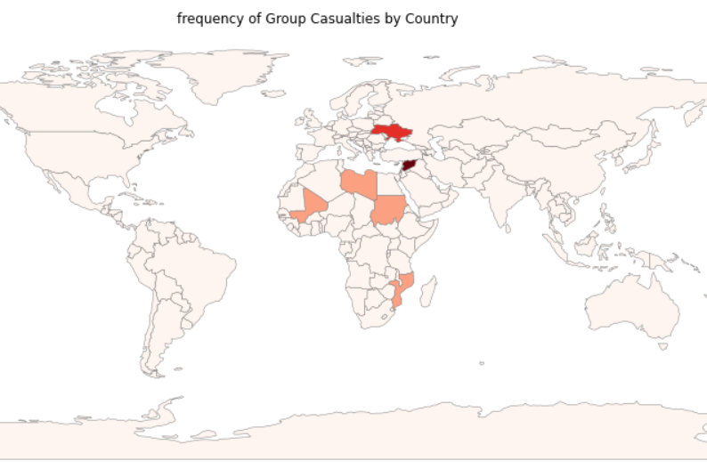





Casualties and Number of Operations Maps

Slide 6
Web Scraping for Human Rights Violations Keywords
Searched for phrases related to human rights violations like “violations”, “Abuse”, “torture”, “Persecution”, and “discrimination”
Table summarizing the number of times each keyword was found per website

Slide 7
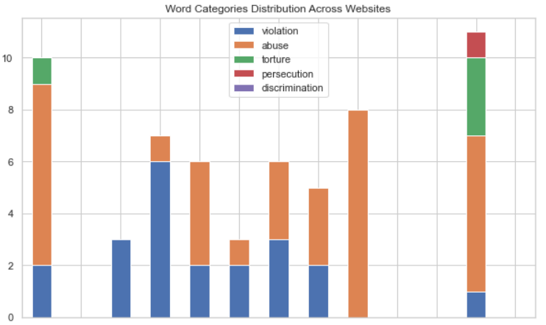
Bar Chart of the Keywords
Better showing the distribution of all the keywords among the websites

Slide 8

Next Time:

